Slide 1
Implementation of
Clustering Analysis
Jen-Yin Chao, Meng-Tse Li
Notes:
Good evening everyone, my name is Meng-Tse Li and today I am going to do my final project presentation with Jen-Yi Chao. Our presentation topic is clustering analysis. Let’s get it started.

Slide 2
AGENDA
Introduction :
Classification and Clustering
Clustering: Hierarchical and Non-Hierarchical
Approach:
Implementation of Hierarchical Algorithm
Implementation of Hierarchical Algorithm
Result:
Comparison
Conclusion
Notes:
This is our agenda for this presentation. The first thing we are going to talk is introduction, with classification and clustering, and Hierarchical and non-hierarchical clustering. Then next we are going to talk about our approach of implementing hierarchical and non-hierarchical algorithms. Last, The are going to discuss about the result of comparing our algorithms with R’s packages.

Slide 3
Introduction
Classification and Clustering
Clustering: Hierarchical and Non-Hierarchical
Meng-Tse Li
Notes:
Ok, so introduction. First we are going to discuss about the classification and clustering.

Slide 4
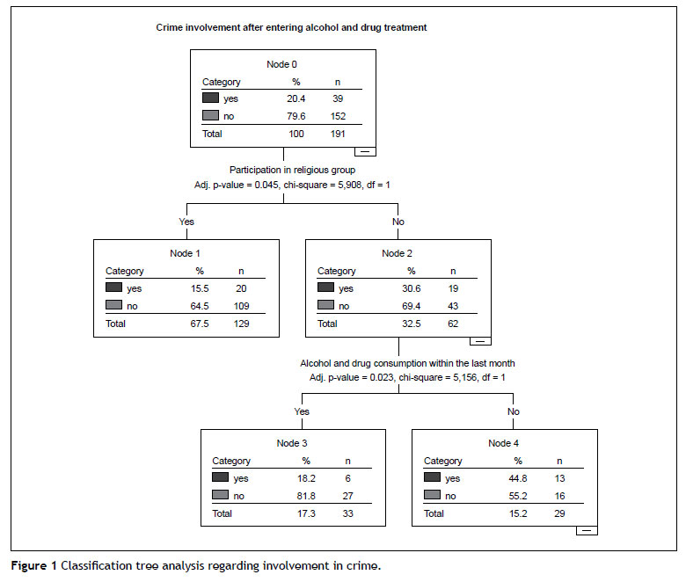
Introduction – Classification
Categorize new observation data
Use differences to train model
Supervised model
Notes:
Classification is a process related to categorization. Assume you know something of your data then, the idea will be, capitalize what you know. For example, let’s say we give our computer 100 dogs pictures and 100 cat pictures, then we would like to do a training algorithms, so if we give our computer a new dog or cat picture, it could actually classify that as a dog or cat. And that’s the idea of supervised learning. That you label the data ahead of time in this process so you can make future decision base on that learning process.

Slide 5
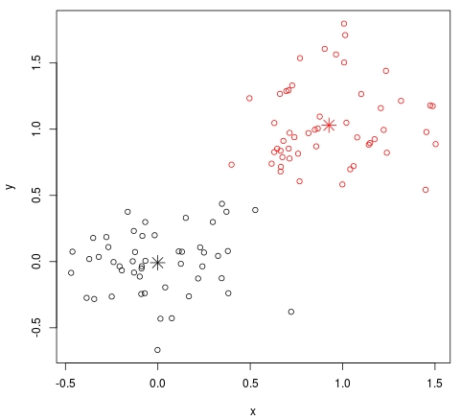
Introduction – Clustering
Pattern Recognition
Use similarity to train model
Unsupervised model
Notes:
So the idea here is just as it sounds, is that basically you are going to generate an algorithm on your computer that is going to look for patterns in the data. You are not going to label any of the data, you are not going to tell the computer what kind of data it is. The goal of the algorithm itself is to discover there patterns in the data itself. So how do we do it?

Slide 6
Introduction – Clustering: Hierarchical
Compute the distances btw pts & pts
Combine the closest points as a group iteratively
Notes:
The key operation of hierarchical clustering is to repeatedly combine two nearest points/clusters. So first we compute the distances between points and then we combine the closest points.

Slide 7
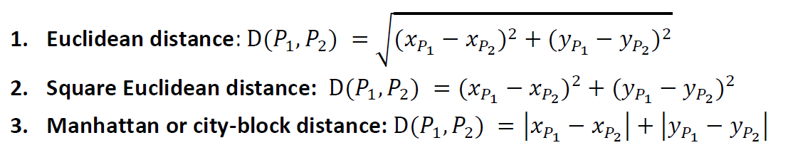
Introduction – Clustering: Hierarchical
Ways of calculating distance:
Notes:
There are 3 ways to calculating the distances, they are Euclidean distances, square Euclidean distances, and Manhattan distances. Just notice that if you use different method to calculate distances, it will give you slightly different results.

Slide 8
Introduction – Clustering: Hierarchical
Ways of choosing point to represent group:
Single Linkage
Complete Linkage
Average Linkage
Ward’s Method
Notes:
And here are 4 ways to choose the point to represent group.
The first one is single linkage method, which chooses the shortest distances.
The second one is complete linage method which choose the longest distances.
The third one is just by its name, it chooses the average distances.
For the sake of time, we are going to past the ward’s method.

Slide 9
Introduction – Clustering: Non-hierarchical
Randomly assign each points to groups
Reassign unstable points to other group iteratively until stable
Group 2
Group 1
Notes:
For non-hierarchical clustering. Let’s say first, we randomly assign our points into three groups. Then we find the unstable points which is closer to other groups and reassign the point to that group. We keep doing this process until there is no unstable points.

Slide 10
Approach
Implementation of Hierarchical algorithm
Implementation of Non-Hierarchical algorithm
Meng-Tse Li
Jen-Yin Chao

Slide 11
Approach
library(datasets) import pk for data import
library(ggplot2) import pk for outcome plotting
source(“Hierarchical.R”) import self-designed function “hier”
source(“Nonhierarchical.R”) import self-designed function “non_hier”
#Clustering with self-designed algorithm
df_dier <- hier(data, normalize, groupNum=3)
df_nondier <- non_hier(data, normalize, groupNum=3)
#Clustering with package
library(cluster) import pk for hierarchical clustering
d <- dist(data, method=”manhattan”) compute the distances between datasets
fit <- hclust(d, method="average") hierarchical clustering
groups <- cutree(fit, groupNum=3) get the group outcome of clustering
iris.kmeans <- kmeans(data, groupNum=3) k-means clustering
Notes:
This is our main script. Including two self-implement algorithms and two R’s packages.

Slide 12
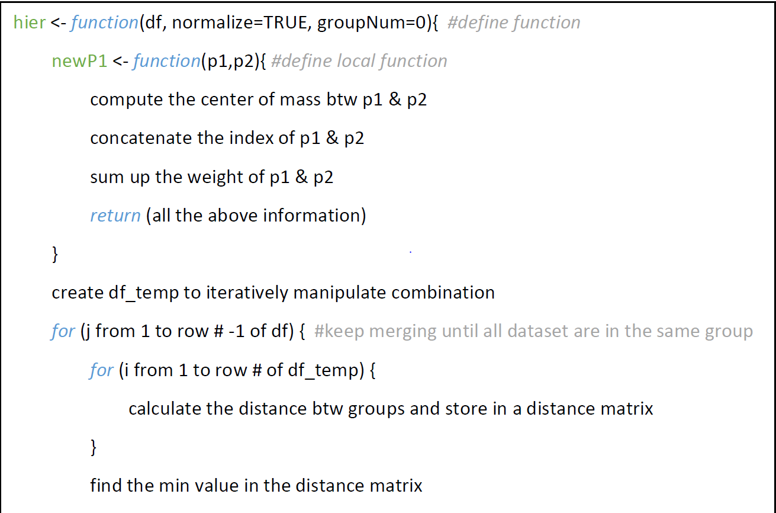
Approach – Hierarchical
Notes:
For this self-made hierarchical algorithm, we first calculate each point’s distance with all points in the data set and stored the result into matrix. Then we find the shortest distances between two points in the matrix and merge them as a new group.
We keep iterating this process until all dataset are in the same group.

Slide 13
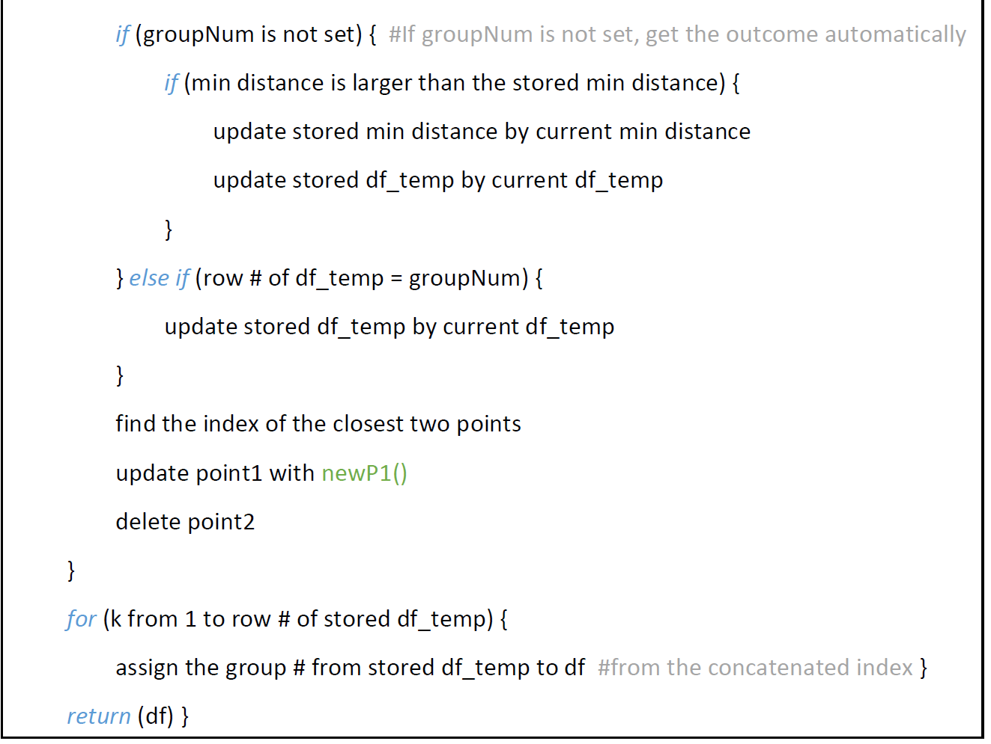
Approach – Hierarchical

Slide 14
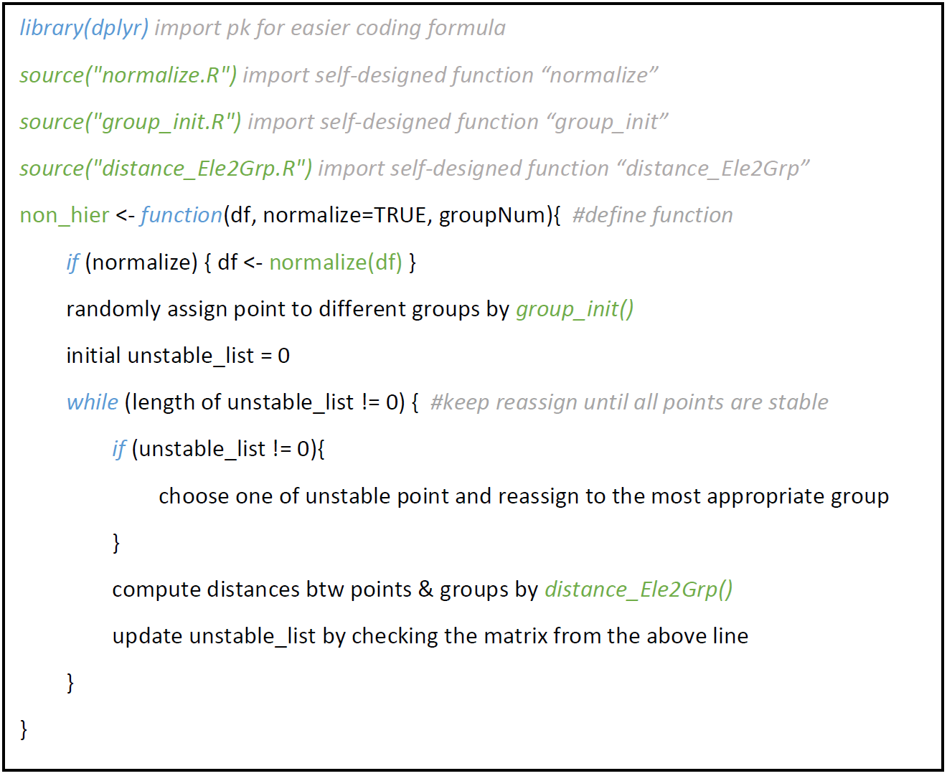
Approach – Non-Hierarchical
Group 2
Group 1
Notes:
It’s the self-designed non-hierarchical part.
As what we said before, first, we randomly assign the points to different groups.
After that, when it is the first time to get in the while loop, the algorithm will compute the distances btw pts & the centers of group to see which points are unstable, which means they are closer to the center of the other groups, and store those points in the unstable list.
So, the second time we go back to the beginning of the while loop, it will randomly choose one of the unstable point from the list and reassign it to the most appropriate group.
And the while loop when keep going until all the points are stable.

Slide 15
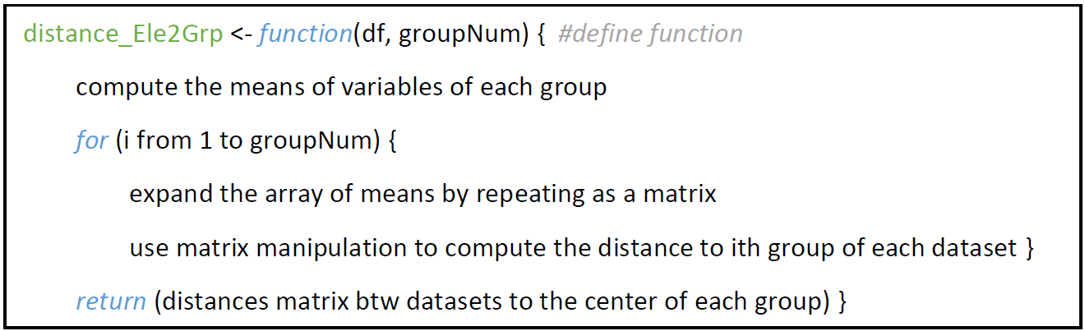
Approach – Non-Hierarchical
Group 2
Group 1
Notes:
Here is the other function that helps us to compute the distances btw points and groups.
Because we use the matrix manipulation, R can calculate faster and has lower complexity.
As the result, the complexity here is only theta of the number of group.

Slide 16
Result
Result Comparison with R Packages
Conclusion
Jen-Yin Chao

Slide 17
Comparison – Efficiency
Both our algorithms have larger run time than R packages.
The biggest difference between our algorithms and R’s packages is the complexity of computing distances.
Notes:
The function in R only uses a lower triangular matrix to represent distances, while we use a full matrix.

Slide 18
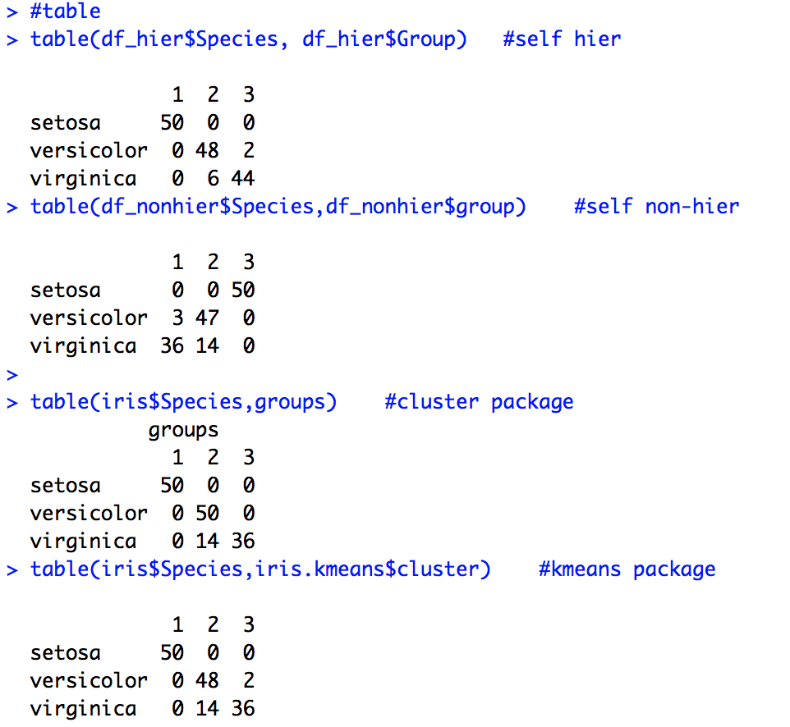
Comparison – Table of Clustering
The result looks slightly different.

Slide 19
Comparison – Plots of Data: Iris
Notes:
On the left hand side is the dendrogram of the clustering. If we want to separate these data into 3 groups, it will merge points in this way.
The right hand side plot is the dot plot of iris species. Just by observing the scattering of data, we can easily determine the data in red must be different from the others, but it’s hard to set a line to separate the data in blue and green into two groups. So, let’s see how will the algorithms deal with these data.

Slide 20
Comparison – Plots of Hierarchical
R’s Package
Self-design Algorithm
Notes:
Both the outcome from package and our algorithm are quite similar to the really species separation.

Slide 21
Comparison – Plots of Non-hierarchical
R’s Package
Self-design Algorithm
Notes:
Same to the non-hierarchical part, which performs well too.

Slide 22
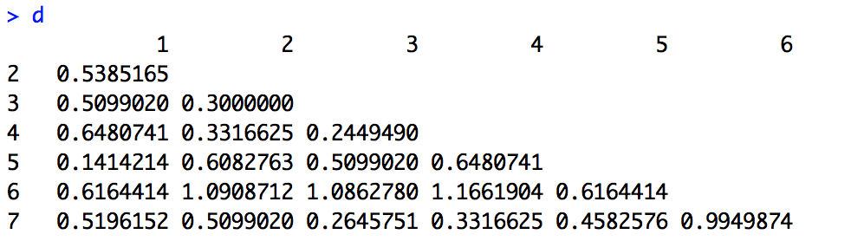
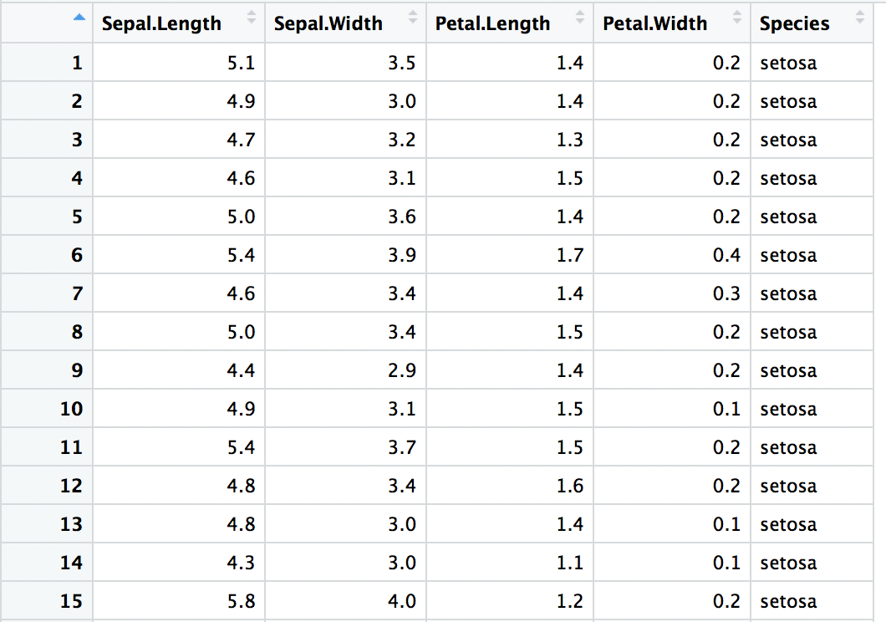
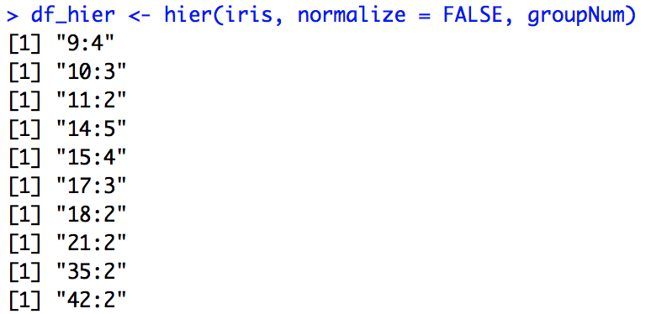
Comparison – What causes the difference?
Distance matrix
Iris data
Lots of multiple choices while processing
Notes:
There are some equal value in the distance matrix. Which combination to choose?
If we take a look at the data, we can find out that the variance of data is quite small, leading that sometimes there are more then one combination have the minima distance.
In our case, we use the Euclidean distance, which should has lower chance to come out with multiple choices while merging, compare to Manhattan distance, but there are still a lot.

Slide 23
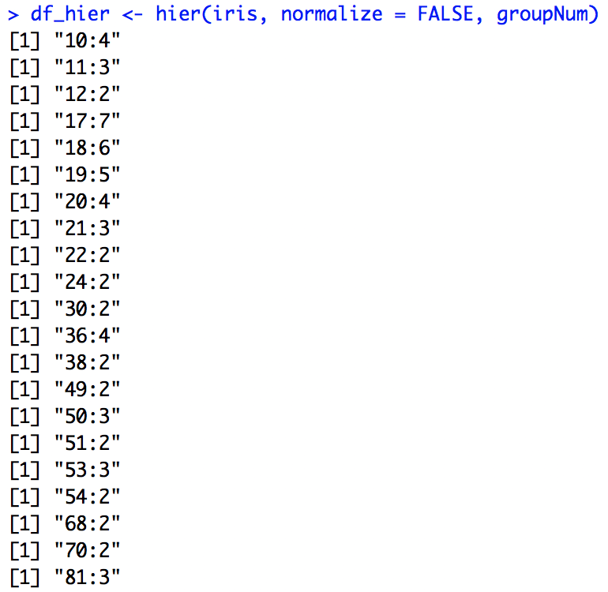
Comparison – Times of Multiple Choices
10 times for Euclidean dist.
21 times for Manhattan dist.
Notes:
So, we use Manhattan distance to do the clustering again to see whether the chance of multiple choices happening increase and what will the outcome be.
Here, you can see that, indeed, depending on the different way of calculating distance, Manhattan distance causes more times of multiple choices.

Slide 24
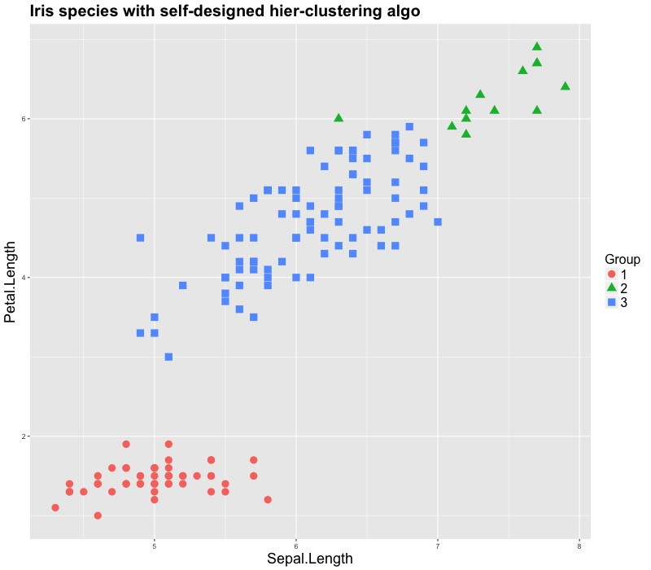
Comparison – Plots of Hierarchical (Manhattan)
R’s Package
Self-design Algorithm
Notes:
And the clustering outcome of hierarchical becomes quite different from the Euclidean one.

Slide 25
Comparison – Plots of Non-hierarchical (Manhattan)
R’s Package
Self-design Algorithm
Notes:
But in non-hierarchical part, the algorithm will do the adjustment iteratively, so the outcome btw package and our algorithm will be similar.

Slide 26
Conclusion
R’s package has better performance over our algorithm.
We have successful designed our algorithm with accurate outcome.
Two ways to improve our algorithms:
Use only lower (or higher) triangular matrix.
Only update the distances with specific group.

